Slide 1

Explore Wayanad!
Vaishnavi V

Slide 2
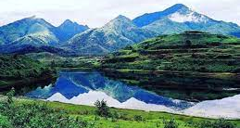
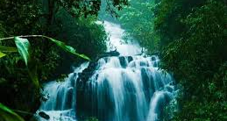
Introduction
This project is targeted to be helpful for those who wish to explore Wayanad.
Wayanad is a district in north-east Kerala. Wayanad is a place that is suitable for visiting during any time of the year, and is a famous tourist spot among adventurers
Wayanad is a hill station. Every tourist spot in this district will fill the traveler with peace and tranquility.
However, since it is a hilly region, different tourist spots are spread across the hilly regions, and not every spot has restaurant facilities near it. Food, is an important part of any trip. And the availability of healthy food is an important consideration while planning a trip.

Slide 3
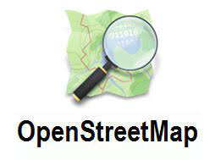

APIs Used for Data Acquisition

Slide 4
OpenStreet Map API – Used for providing tourist destinations in Wayanad.
Foursquare API – Used for providing nearby restaurant information for each of the tourist spot identified by the OpenStreet map API.

Slide 5
Data Cleaning
Openstreet API returns around 500 tourist destinations in Wayanad in a radius of 50 Km.
The data is cleaned to retain only the places which have a rating greater than 0.
This leaves us with 397 entries.
For each spot, the data we retireve using the two APIs include Name, distance from Wayanad, Rating, Latitude, Longitude, Closest Restaurant and distance of the restaurant from the place of attraction.

Slide 6
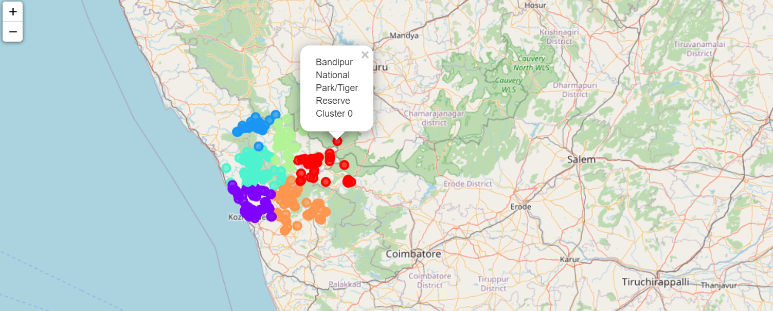
K-Means Clustering
K-Means algorithm has been used to cluster the 397 locations in Wayanad into 6 locations using their geospatial data.

Slide 7
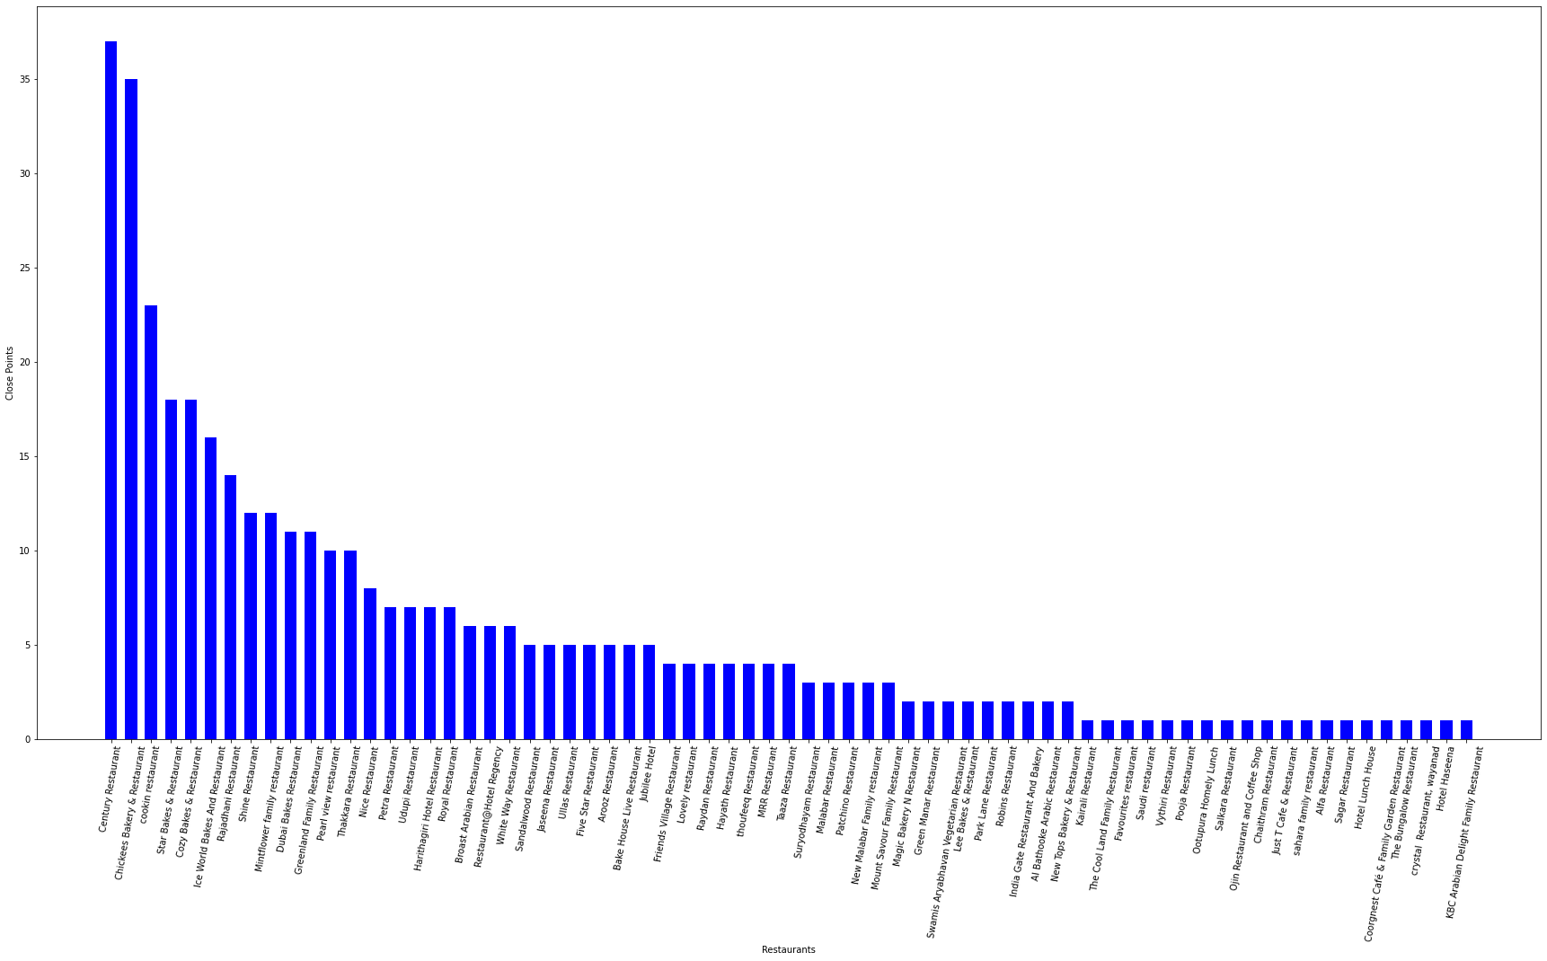
Restaurant distribution across Wayanad

Slide 8
Conclusion
The purpose of this project was to provide useful information and guide those who want to visit Wayanad.
The graph shows that there are many restaurants that are close to multiple tourist attractions.
The 397 locations have divided and mapped into 6 clusters.
With this data, one will always have an idea about where to find good food and can plan their trip accordingly!

